Slide 1

Comparative Study of Popular Operating Systems
Architectural Paradigms, Resource Scheduling, and Real-World Suitability: Windows, Linux, macOS, and Android
Gowtham M
192373060

Slide 2


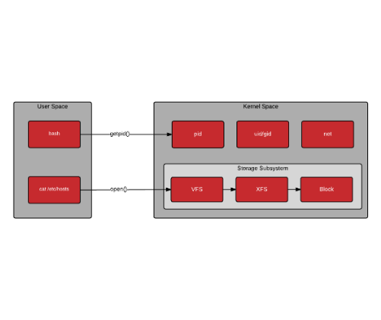
The Role of Modern Operating Systems
Hardware Virtualization Layer
Transforms complex physical components into standardized, clean programmatic interfaces.
Fair Resource Arbitration
Schedules CPU cycles, dynamically manages virtual memory, and mitigates starvation.
Protection & Ring Security
Enforces strict privilege boundaries between unprivileged user code and kernel space.

Slide 3
Architectural Taxonomy & Execution Models
Monolithic
Hybrid NT
XNU Hybrid
Linux & Android
Microsoft Windows
Apple macOS
All primary OS services and device drivers execute directly within single kernel address space.
Combines microkernel modular abstraction with monolithic execution speed for graphics and I/O.
Composite foundation merging Mach 3.0 microkernel primitives with complete FreeBSD components.
•
Zero IPC overhead for internal drivers
•
Hardware Abstraction Layer (HAL) base
•
Mach message passing and thread control
•
Dynamic Loadable Kernel Modules (LKM)
•
Subsystem servers isolate user runtimes
•
POSIX compliance via FreeBSD layers

Slide 4
Process & Thread Scheduling Algorithms
Linux CFS & EEVDF
Windows Priority Preemptive
Completely Fair Scheduler utilizes red-black trees based on virtual runtime metrics.
Multi-level Feedback Queue across 32 distinct priority tiers with dynamic foreground boosting.
O(log N) latency • Deterministic fairness
GUI responsiveness • Starvation decay
macOS QoS & Mach Threads
Android Cgroups & Energy-Aware
Grand Central Dispatch binds thread priority dynamically to declared Quality-of-Service tiers.
EAS (Energy Aware Scheduling) allocates interactive tasks to efficient or performance CPU clusters.
Asymmetric core targeting • Energy priority
Heterogeneous big.LITTLE • Thermal throttling

Slide 5
Virtual Memory, Paging & Storage Frameworks
Operating System | Virtual Memory Strategy | Memory Pressure Handler | Primary File System
Windows | Demand paging with Working Set trimming | pagefile.sys backing + RAM compression | NTFS / ReFS
Linux | Buddy allocation system + SLAB / SLUB | Kernel Out-Of-Memory (OOM) Killer | ext4 / Btrfs / XFS
macOS | Unified memory architecture with Mach VM | In-line 4:1 WKdm memory compression | APFS (Apple File System)
Android | Zero secondary disk swap (flash protection) | Low Memory Killer Daemon (LMKD) + zRAM | EROFS / F2FS / ext4

Slide 6
Security Paradigms & Privilege Boundaries
Windows
Linux
macOS
Android
VBS & Hardware TPM
MAC & Namespaces
SIP & Secure Enclave
UID Sandboxing
Virtualization-Based Security runs isolated Hyper-V micro-instances safeguarding credentials.
SELinux / AppArmor Mandatory Access Control combined with cgroups for container isolation.
System Integrity Protection restricts root modifications while hardware Enclave stores keys.
Assigns discrete Linux User IDs per application, strictly sandboxing files, memory, and sensors.

Slide 7
Core Technical Metrics Across Systems
Attribute | Windows (NT) | Linux | macOS | Android
Kernel Type | Hybrid NT Kernel | Monolithic (Modular) | Hybrid (XNU: Mach + BSD) | Modified Monolithic Linux
License Model | Proprietary Commercial | FOSS (GPL v2) | Proprietary / OpenDarwin | Apache 2.0 / GPL Kernel
Hardware Support | Universal OEM Ecosystem | Vast (x86, ARM, RISC-V) | Apple Silicon Exclusive | ARM / SoC Ecosystem
Driver Model | WDF (KMDF / UMDF) | In-tree Kernel Drivers | DriverKit (User Space) | HIDL / AIDL HAL Interfaces
Package System | MSI, EXE, winget | dpkg, RPM, Flatpak | App Bundles (.app), brew | APK / AAB Packages
Target Domain | Enterprise & Gaming | Servers, Cloud & IoT | Creative & Engineering | Mobile & Embedded Edge

Slide 8


Real-World Deployment & Ecosystem Fit
Desktop Dominance & Corporate Infrastructure
Windows maintains >70% desktop share driven by DirectX 12 gaming and Active Directory.
Cloud, Supercomputing & Data Centers
Linux powers 100% of top 500 supercomputers and over 90% of global cloud infrastructure.
Global Edge & Mobile Ubiquity
Android commands >70% mobile market share across 3+ billion active consumer devices.

Slide 9
Summary of Engineering Trade-Offs
01
02
03
Architecture Dictates Focus
Workload-Driven Selection
Hardware Co-Design
No single kernel design solves all paradigms. Monolithic architectures deliver peak bare-metal throughput, while hybrid kernels excel in modular abstraction.
Deployment depends strictly on constraints: deterministic batch scalability (Linux), backwards compatibility (Windows), or strict sandboxing (Android/macOS).
Modern operating system efficiency increasingly relies on tight hardware integration (e.g., Apple Silicon, ARM big.LITTLE, and hardware hypervisor enclaves).
Throughput vs Modularity
Context-Dependent Value
Silicon-Kernel Synergy

Slide 10
References & Source Materials
[1] Silberschatz, A., Galvin, P. B., & Gagne, G. (2018). Operating System Concepts (10th ed.). John Wiley & Sons.
[2] Stallings, W. (2018). Operating Systems: Internals and Design Principles (9th ed.). Pearson Education.
[3] Russinovich, M., Solomon, D. A., & Ionescu, A. (2017). Windows Internals: Part 1 & 2 (7th ed.). Microsoft Press.
[4] Love, R. (2010). Linux Kernel Development (3rd ed.). Addison-Wesley Professional.
Thank You for Your Attention

Slide 11


Image Sources
https://www.redhat.com/cms/managed-files/2015/07/user-space-vs-kernel-space-basic-system-calls.png
Source: www.redhat.com
https://miro.medium.com/v2/resize:fit:1400/1*NNtdk02dDhbUMqkCyMfmRA.jpeg
Source: medium.com

